Slide 1
Smart Agriculture System using IoT
By Madhav Rathi
IoT App Developer at SmartInternz
Notes:
Hi Guys,
I am Madhav

Slide 2
Project Overview
Smart Agriculture System is a commercially scalable model which is being built to reduce the efforts of Farmers. It intends to take care of one of the most important part of farming which is watering the crops. It needs to be done at the right time, in right amount and right conditions.
There are many things to take care of, while considering the watering of crops. If the water is too much, the crops can get damaged by water logging. If we water on a rainy day, the extra rainwater may tamper with the growth of crop. If the farmer forgets to turn on the pump for a day or two due to any reason, it can again make the soil too dry for the plants to get their daily nutrition level.
Considering many facts, this project is chiefly focused on automating the process of water pump and providing the farmers with an application where they can see the status of pump, moisture of the soil, humidity, temperature as well ass weather forecasting. The ultimate goal of this project is to increase the quality of yield by taking care of irrigation process and start the revolutionary era of Farmers by bringing technology in this domain.

Slide 3
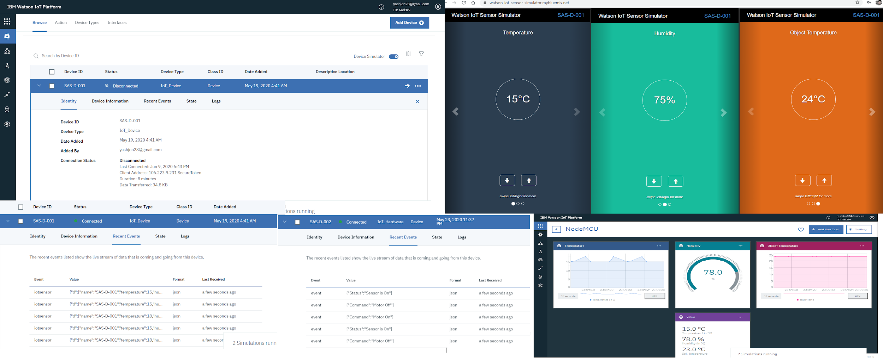
Use Of IBM Watson
Here we have all our working components such as the IoT sensor, The device which connects to the sensor and uploads data into the IBM Cloud, The motor which takes input from the web app and then uploads the input via python code on the Cloud.
The bottom corner of the image shows some cards which displays the data in a visually appealing way than just numbers such as line graphs or gauge which makes it easy to understand.

Slide 4
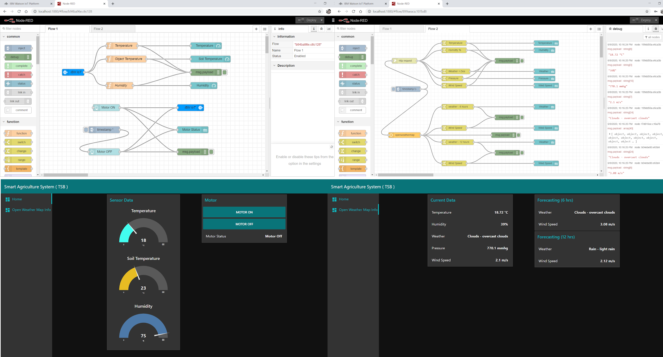
Functioning of the App
In the First flow, we have IBM nodes to get the IoT sensor data from IBM cloud and push the Motor On / Off commands from the web dashboard back to the IBM Cloud.
For the second Flow, we have 2 methods to get data from the Open Weather Map. One is Http request which I’m using to get the current weather data and display to the dashboard. The other method is to use the OWM nodes provided to get the data which I’m using for forecasting data here.

Slide 5
THANK-YOU

